Slide 1
Basic Improvement Methodology
Review of QI 102: How to Improve with the Model for Improvement

Slide 2
Lecture Objectives
List the three questions in the Model for Improvement
Identify the key elements of an effective aim statement
Identify three kinds of measures: process, outcome, and balancing measures
Use change concepts and critical thinking tools to come up with good ideas for changes to test
Test changes on a small scale using the Plan-Do-Study-Act (PDSA) cycle

Slide 3
Lecture Outline
An Overview of the Model for Improvement
Setting an Aim
Choosing Measures
Developing Changes
Testing Changes

Slide 4
How Can We Improve?
1. Will. You must have the will to improve
3. Execution. You must make it real.
2. Ideas. You must have ideas about alternatives to the status quo.

Slide 5
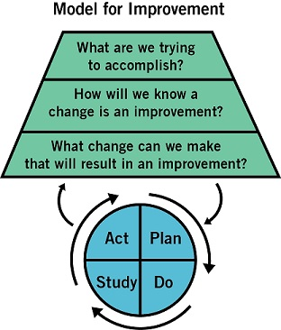
How Can We Improve?
1. Will. You must have the will to improve
3. Execution. You must make it real.
2. Ideas. You must have ideas about alternatives to the status quo.

Slide 6
Improvement Methods
Model for Improvement
Lean
Six Sigma
Having a standard road map for improvement — rather than the specific framework you decide to use — is what’s most important

Slide 7
Three Questions and a Cycle

Slide 8
Step 1: Set an Aim
How good?
For whom?
By when?

Slide 9
Step 1: Set an Aim
How good?
For whom?
By when?
Bold
Realistic
Clear
Concise
Measureable
Meaningful

Slide 10
Which is the better aim statement?
Reduce all types of hospital-acquired infections by as much as possible, as quickly as possible.
Decrease the rate of hospital-acquired pneumonia for patients in the ICU from 23 infections per 1,000 catheter days to less than 5 infections per 1,000 catheter days by May 1.

Slide 11
Which is the better aim statement?
Reduce all types of hospital-acquired infections by as much as possible, as quickly as possible.
Decrease the rate of hospital-acquired pneumonia for patients in the ICU from 23 infections per 1,000 catheter days to less than 5 infections per 1,000 catheter days by May 1.

Slide 12
Step 2: Establish Measures
Outcome measures
Process measures
Balancing measures

Slide 13
Step 2: Establish Measures
Outcome measures
Process measures
Balancing measures
Where are we going?
What are we doing?
What else is happening?

Slide 14
Which measure is which?
Average number of times patients receive recommended oral care in 24 hours
Patient and staff satisfaction scores
Rate of hospital-acquired pneumonia per 1,000 catheter days in the ICU

Slide 15
Which measure is which?
Average number of times patients receive recommended oral care in 24 hours process
Patient and staff satisfaction scores balancing
Rate of hospital-acquired pneumonia per 1,000 catheter days in the ICU outcome

Slide 16
Step 3: Developing Changes
Process analysis tools
Benchmarking
Technological solutions
Creative thinking
Change concepts

Slide 17
Change Concepts
Eliminate waste
Improve workflow
Optimize inventory
Enhance the producer-customer relationship
Change the work environment
Manage time
Manage variation
Design systems to prevent errors
Focus on the design of products and services

Slide 18
What changes could improve oral care in the ICU?
Improve workflow
Optimize inventory
Change the work environment
Manage variation
Design systems to prevent errors
Other ideas?

Slide 19
What changes could improve oral care in the ICU?
Improve workflow Ensure mouth-cleaning supplies are kept in ready-to-go state
Optimize inventory Ensure toothbrushes, mouthwash, etc. are consistently available
Change the work environment Train hospital staff on proper mouth-cleaning technique and importance
Manage variation Update oral care policy to be consistent with CDC guidelines for all patients
Design systems to prevent errors Post the oral-care protocol in visible places

Slide 20
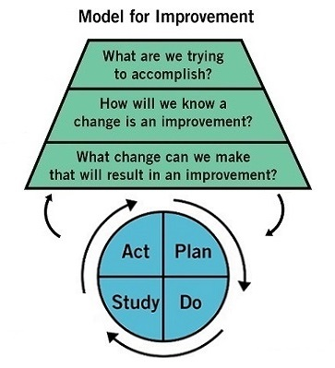
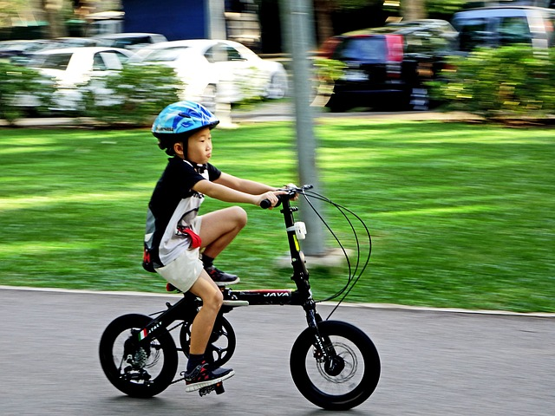
Step 4: Testing Changes

Slide 21
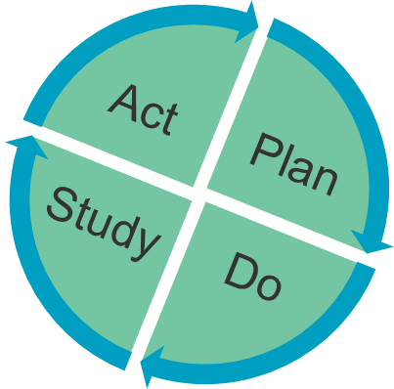
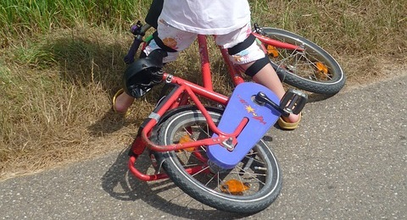
Step 4: Testing Changes
Plan
Questions & predictions
Who/what/where/when?
Do
Observe the test
Document results
Study
Draw run charts
Analyze the data
Act
Refine the change and plan for the next cycle

Slide 22
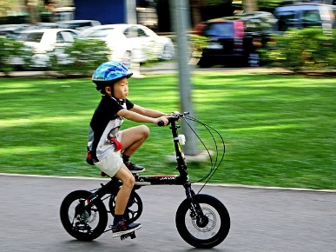
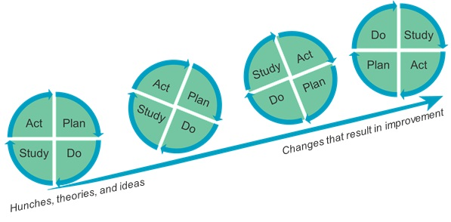
Linking PDSA Test Cycles
Start small
Think ahead
Don’t wait to begin!

Slide 23
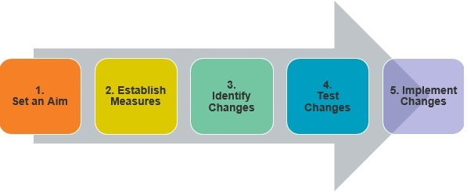
Review: Using the MFI to Improve Care

Slide 24
Video
https://youtu.be/8Q7qnNpTWxM
http://www.ihi.org/education/IHIOpenSchool/resources/Pages/Activities/PDSACyclesFromCLABSIsToCucumbers.aspx

Slide 25
Discussion
In the example about CLABSIs, what would be a reasonable next PDSA cycle?
What PDSA cycles do you use in your daily work, even if that’s not the name you use for them?
What’s the value of a failed PDSA cycle?
Think about the last PDSA cycle you ran in your personal life — even if you didn't know it was a PDSA cycle at the time. Was it successful? Why or why not?
http://www.ihi.org/education/IHIOpenSchool/resources/Documents/Facilitator_PDSACyclesFromCLABSIsToCucumbers.pdf

Slide 26
Exercise
Go to http://www.ihi.org/education/IHIOpenSchool/Courses/Documents/QI102_exercise.pdf and practice planning an improvement project.
Ask a partner to review your work, using the reviewer questions as a helpful guide. Refine your worksheet based on peer feedback.

Slide 27
Discussion
How did you select your aim, measures, and changes?
What is your level of confidence you will be able to make this change?
How do you think having this written plan will help you?
What did you learn during this activity?
http://www.ihi.org/education/IHIOpenSchool/Courses/Documents/QI102_exercise.pdf

