Slide 1
Fundamentals of Health Care Improvement
Review of QI 101: Introduction to Health Care Improvement

Slide 2
Lecture Objectives
Describe common challenges for health care systems around the world
List the six dimensions of health care, and the aims for each, outlined by the Institute of Medicine (IOM) in 2001
Explain the value of improvement science in health care

Slide 3
Lecture Outline
Health and health care today
The Institute of Medicine’s aims for improvement
Changing systems with the science of improvement

Slide 4
The State of Health Care Today
Providers are becoming more specialized, leading to gaps in communication and care
Populations are aging, with disease burden shifting toward chronic conditions
Patients and families are better informed, wanting more personalized care
Complicated procedures and expensive treatments are more available and desired

Slide 5
Two IOM Reports
1999: To Err Is Human: Building a Safer Health Care System
44,000 to 98,000 Americans dying due to medical errors each year
Equivalent to three jumbo jets crashing every other day; statistics widely reported by the media
2001: Crossing the Quality Chasm: Health Care in the 21st Century
Six dimensions of US health care that need improvement

Slide 6
Six Dimensions of Health Care Quality
 | Safe: Avoiding injuries to patients from the care that is intended to help them
 | Timely: Reducing waits and sometimes harmful delays for patients and providers
 | Effective: Providing the appropriate level of services based on scientific knowledge
 | Efficient: Avoiding waste, including waste of equipment, supplies, ideas, and energy
 | Equitable: Providing care that does not vary in quality because of personal characteristics
 | Patient-Centered: Providing care that is respectful of and responsive to individual patients

Slide 7
How Can We Improve?
“Every system is perfectly designed to get the results it gets.”
The “science of improvement” (however we label it) focuses on changing systems — not people
“Science of improvement”
“Health care delivery science”
“Implementation science”
“Systems strengthening”
“Systems engineering”

Slide 8
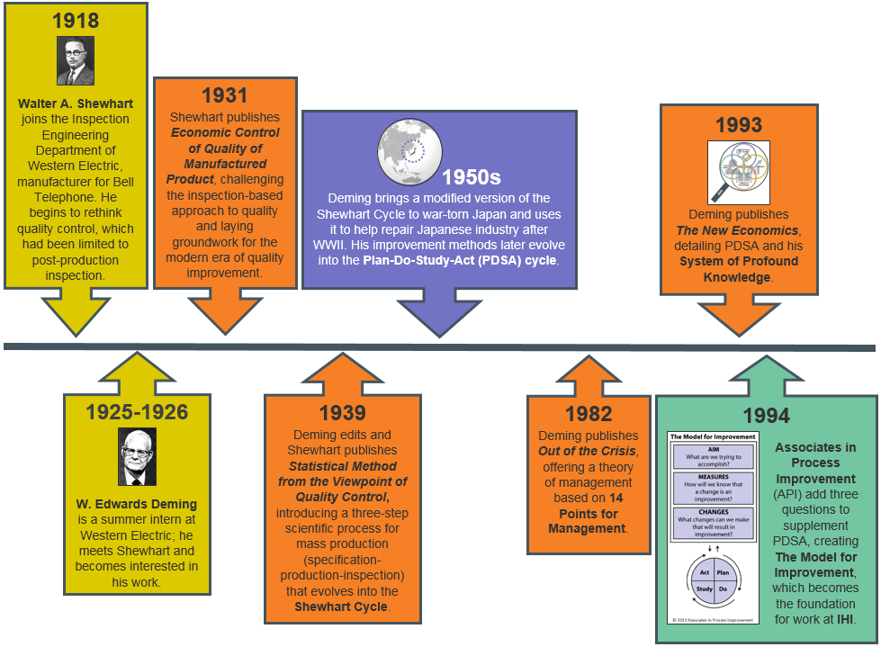
The Evolution of Improvement Science

Slide 9
System of Profound Knowledge
Theory of improvement from W. Edwards Deming
Framework for understanding key aspects of systems
Predecessor of the Model for Improvement

Slide 10
Appreciation of a System
What is the whole system that you’re trying to manage?

Slide 11
Understanding Variation
What is the variation in results trying to tell you about the system?

Slide 12
Theory of Knowledge
What are your predictions about the system’s performance?

Slide 13
Theory of Psychology
What are the important interactions among people in the system?

Slide 14
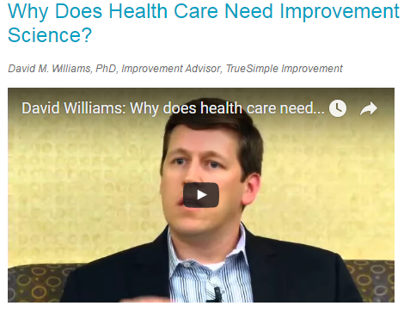
Video
https://youtu.be/XSQr9_VwMCg
http://www.ihi.org/education/IHIOpenSchool/resources/Pages/Activities/williamsNeedImprovementScience.aspx

Slide 15
Discussion
Do you agree that clinicians need improvement methodology to help them change how they work? Why or why not?
When you think about a process in your life (at work or at home) that needs improvement, what’s the first thing that comes to mind? Why?
How can data be helpful in identifying opportunities for improvement?
Have you used improvement science to make changes in your work or home life? What was your experience?
http://www.ihi.org/education/IHIOpenSchool/resources/Documents/Facilitator_ImprovementScience.pdf

Slide 16
Exercise
Go to https://www.medicare.gov/hospitalcompare/search.html
Research your local hospitals or the hospitals in an area of your choice.
Discuss what you learned, referring to the discussion questions at http://www.ihi.org/education/IHIOpenSchool/resources/Documents/QI101_exercise.pdf

