Slide 1
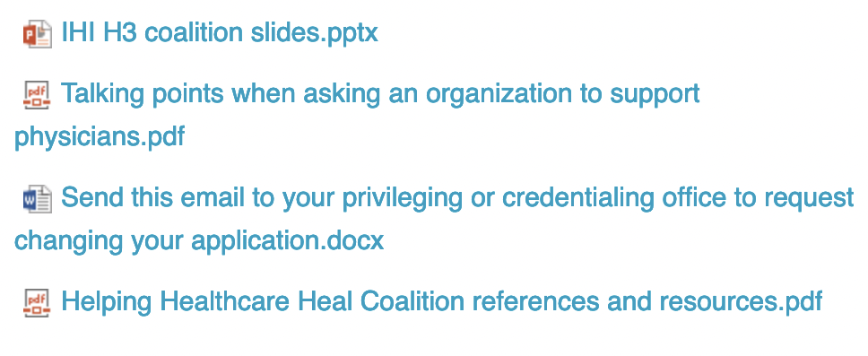
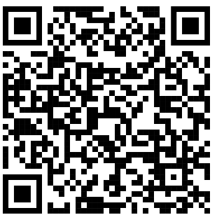
Reduce barriers to colleagues receiving mental health care by revising your application and credentialing form
Notes:
There are barriers to physicians and students seeking mental health care, and the IHI has created a toolkit of resources to help you advocate within your organization to revise applications to overcome these barriers. Please feel welcome to point your smartphone camera at this QR code to link to the website that has a slide set with speaker’s notes, a document of talking points and references when writing or speaking about this topic, and a draft email you can send to your own credentialing office to request revisions to your organization’s application.

